Slide 1
VEHICLE RENTAL SYSTEM
Project Report
Submitted To
Course Teacher
Department: of Computer Science and Engineering (CSE)
=================================================================================================
Submitted By: Group-5
Name: Samira Hasan ID:- 1121003 Name: Tasnim Taaha ID:- 1121029
Name: Jakia Sultana Jerin ID:- 1121027 Name: Mariya sultana ID:- 1121038
Department: Computer Science and Engineering (CSE)
Semester: 2-1
Course Title: Object Oriented Programming (OOP)
Course Code: CSE: 214
=================================================================================================
Project Title
Vehicle Rental System
Submission Date
19-07-2026

Slide 2
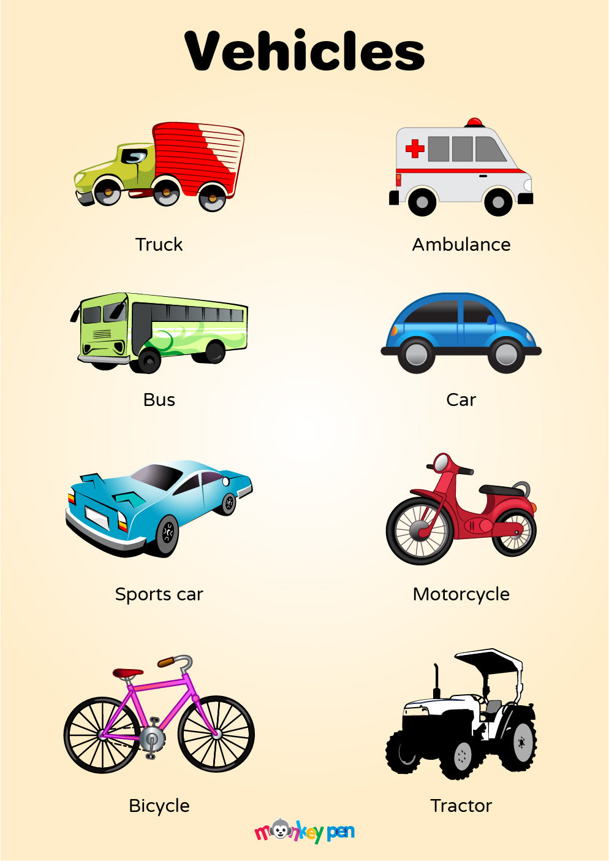
Introduction
The Vehicle Rental System is a console-based application developed using C++. The system helps manage vehicles, customers, rentals, and notes efficiently. It uses Object-Oriented Programming concepts along with file handling to store data permanently.

Slide 3
Objectives
Manage vehicle information.
Manage customer information.
Rent and return vehicles.
Store rental history.
Save data permanently using text files.
Apply Object-Oriented Programming concepts.
Handle invalid user input using exception handling.

Slide 4
Features
Vehicle Management
Customer Management
Rent Vehicle
Return Vehicle
Rental History
Notes Management
Automatic Save & Load
Exception Handling

Slide 5
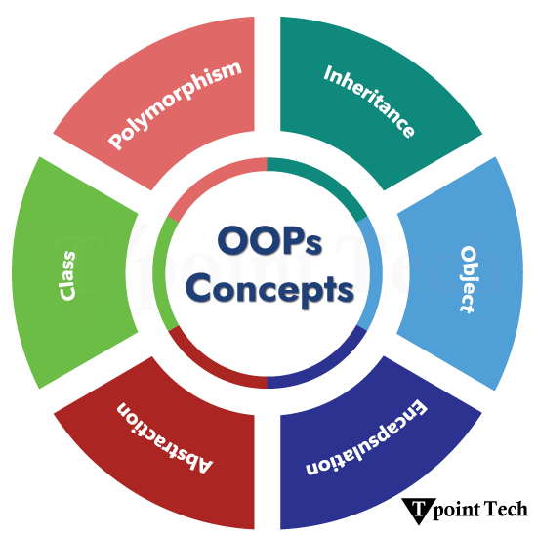
OOP Concepts
Class & Object
Encapsulation
Inheritance
Polymorphism
Constructor
Destructor
Friend Function
Dynamic Memory Allocation
File Handling
Exception Handling

Slide 6
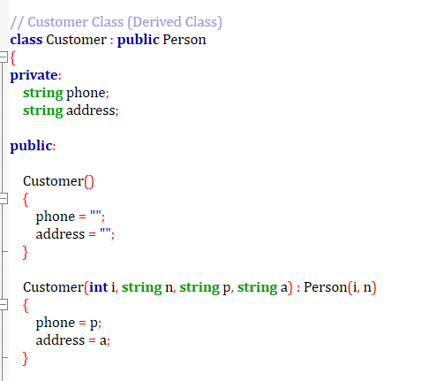
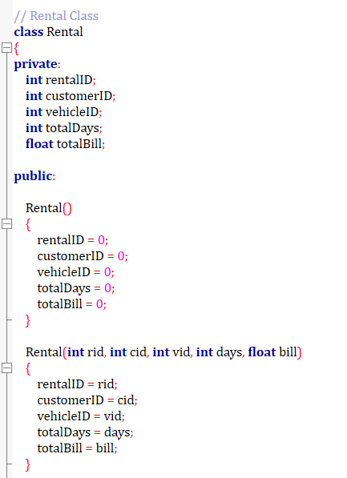
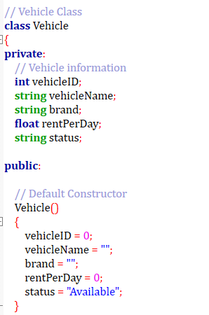
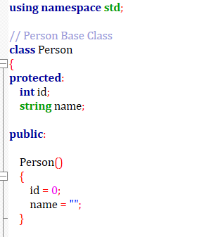
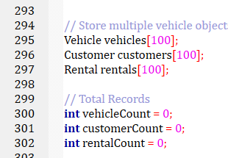
Class & Object
The project is divided into multiple classes to represent real-world entities such as Vehicle, Customer,
Person, and Rental. Objects of these classes are used to store and manage all system data efficiently.

Slide 7
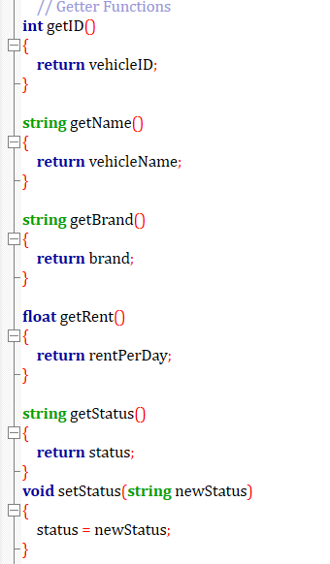
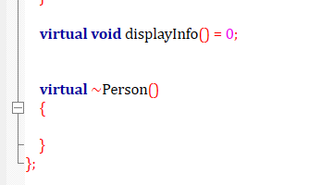
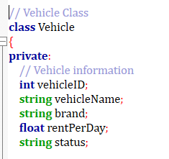
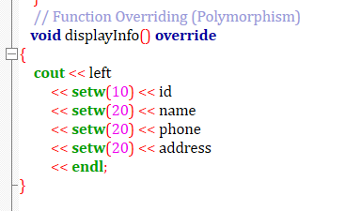
2. Encapsulation
Encapsulation is used to protect vehicle information by keeping data members private. The data can only be accessed or modified through public getter and setter functions, ensuring data security.
3. Polymorphism
Polymorphism is used through function overriding. The Customer class provides its own implementation of the displayinfo() function to display customer-specific information.

Slide 8
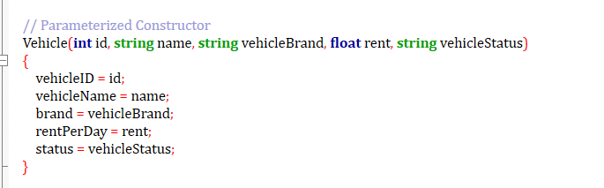
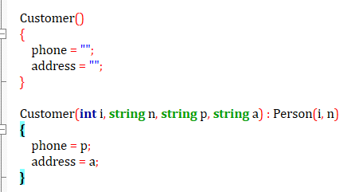
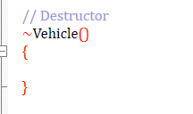
4.inheritance:-
The Customer class inherits common properties such as ID and Name from the Person class. This reduces code duplication and improves code reusability.
5. Constructor:-
Constructors automatically initialize object data when a new vehicle, customer, or rental object is created, reducing manual initialization.
6. Destructor:-
A destructor is included to demonstrate object destruction after program execution. It follows the Object-Oriented Programming principle.

Slide 9
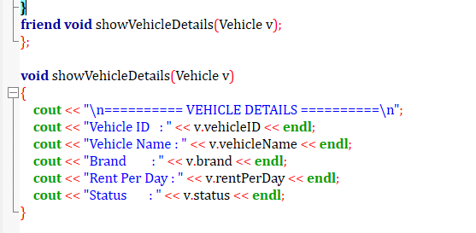
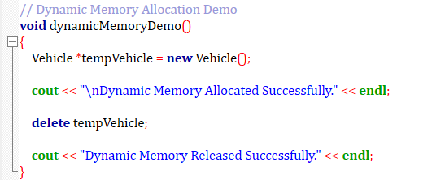
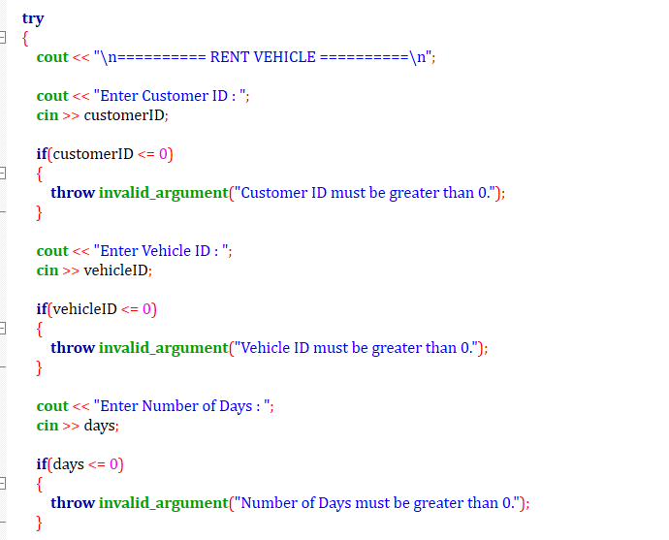
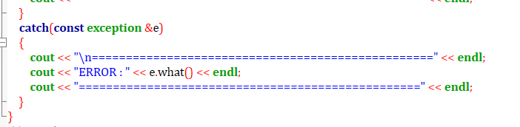
7. Friend Function:-
The friend function is used to access the private data members of the Vehicle class directly and display complete vehicle information.
8. Dynamic Memory Allocation
Dynamic memory allocation is demonstrated using the new and delete operators to create and release objects dynamically during program execution.
9. Exception Handling
Exception handling is used in the rental process to detect invalid Customer ID, Vehicle ID, or rental days and display appropriate error messages without crashing the program.

Slide 10
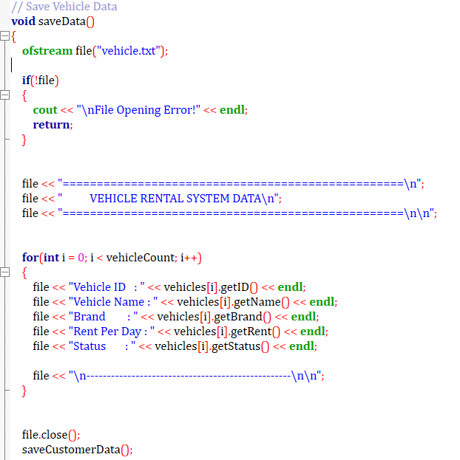
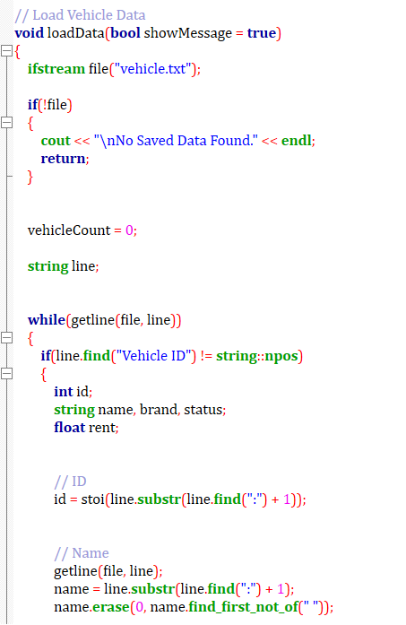
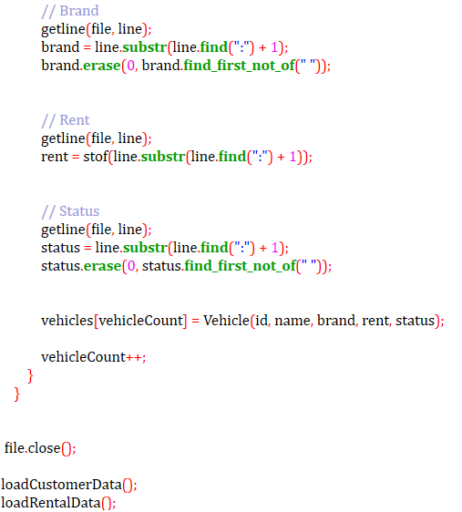
10. File Handling
File handling is used to permanently store vehicle, customer, rental, and notes information. All saved data is automatically loaded when the program starts.

Slide 11
Class Diagram
Rental
rentalID customerID vehicleID totalDays totalBill
displayRental() getRentalID() getCustomerID() getVehicleID() getDays() getBill()
person
id name
displayInfo()
Vehicle
vehicleID vehicleName brand rentPerDay status
inputVehicle() displayVehicle() getID() getName() getBrand() getRent() getStatus() setStatus() isAvailable()
Customer
phone Address
inputCustomer() displayInfo()

Slide 12
Program Flow
Vehicle | Customer | Rental | Return
Start
Save Updated Data
Welcome Screen
Display Result
Load Saved Data
Continue / Exit
Main Menu
Continue / Exit

Slide 13
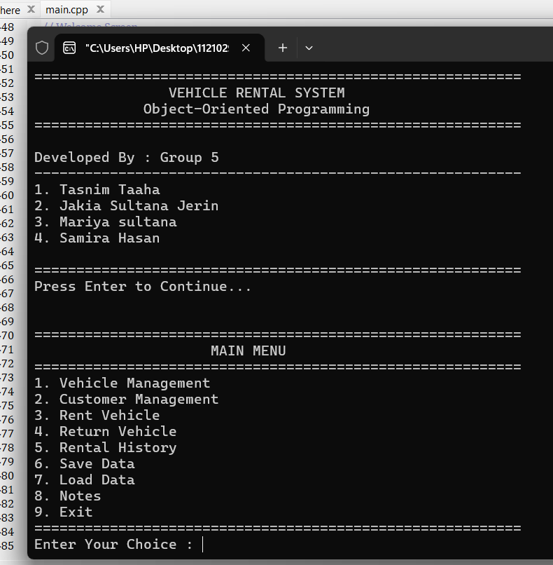
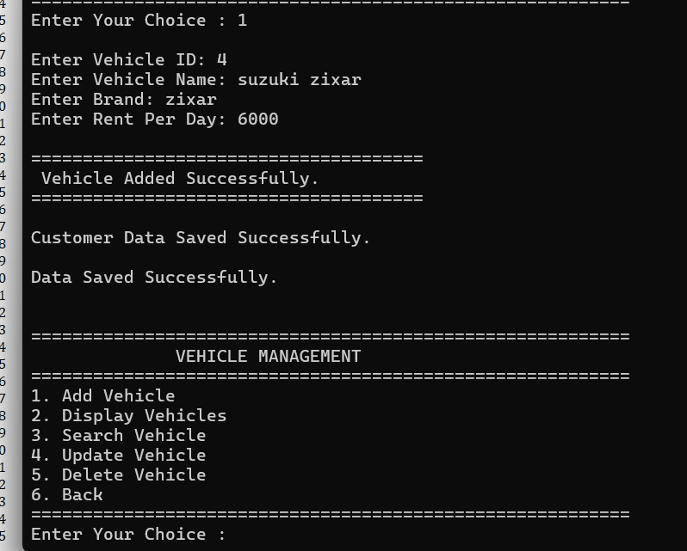
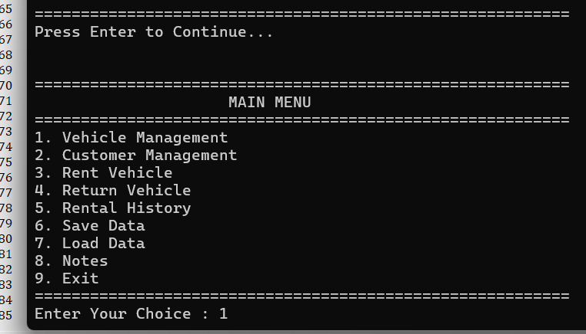
Welcome Screen:- Displays the welcome message when the program starts.
Vehicle Management Menu- Provides options to manage vehicle records.
Main Menu:- Shows the main options of the Vehicle Rental System.

Slide 14
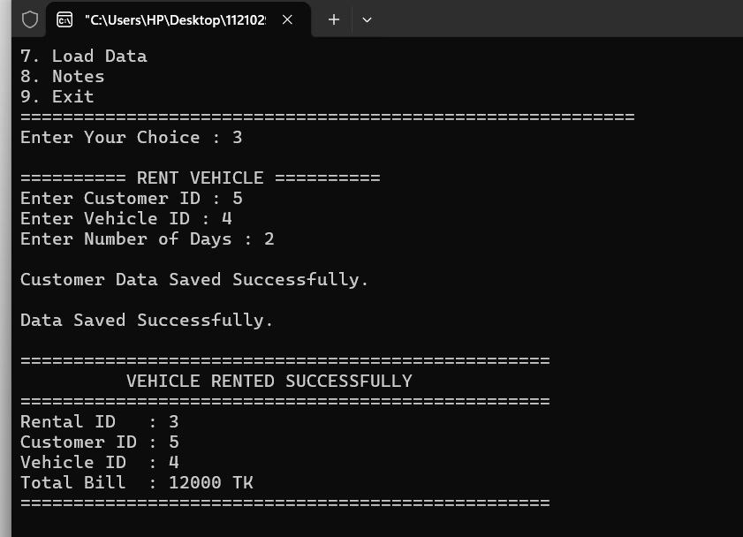
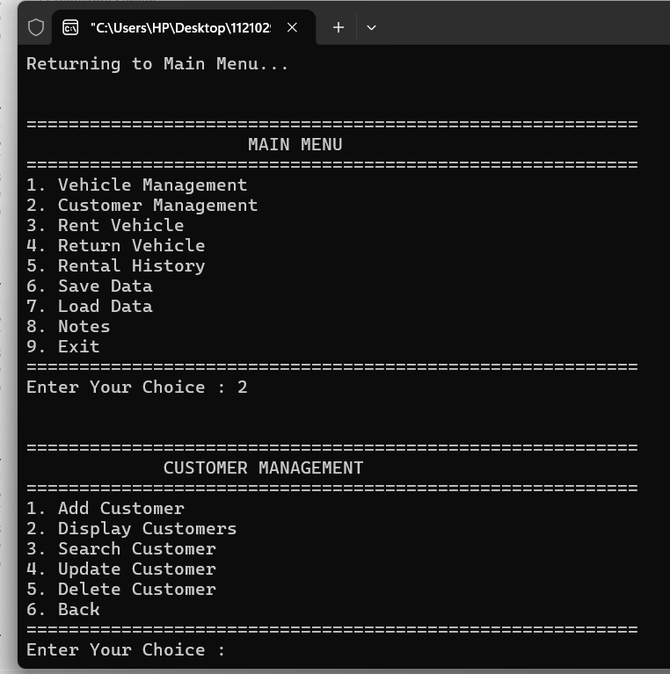
Rent Vehicle :- Allows a customer to rent an available vehicle.
Customer Management Menu:- Provides options to manage customer information.

Slide 15
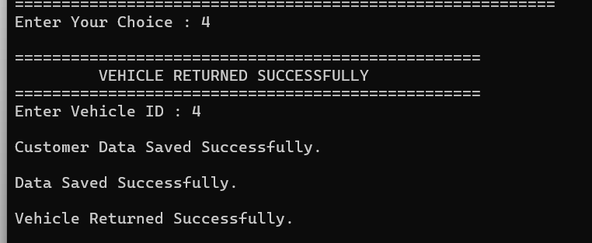
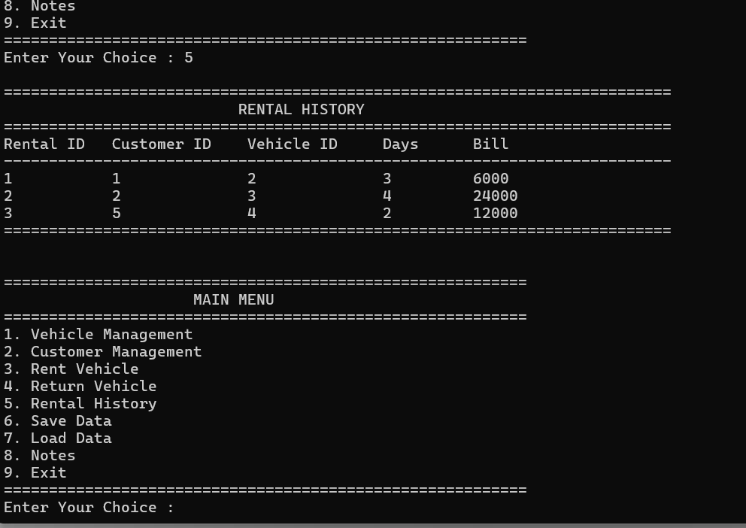
Return Vehicle:- Updates the vehicle status after it is returned.
Rental History:- Displays all previous rental records.

Slide 16
Advantages
Easy to use.
Fast data management.
Permanent data storage.
User-friendly menu system.
Reduces manual work.
Reliable and efficient.
Conclusion
The Vehicle Rental System successfully manages vehicle rental operations using Object-Oriented Programming concepts. It stores data permanently through file handling and provides an efficient and user-friendly console application.

Slide 17
THANK YOU

